Slide 1

Testing code
Stubs

Slide 2
Objectives
In this chapter you'll learn about creating and using stubs.

Slide 3
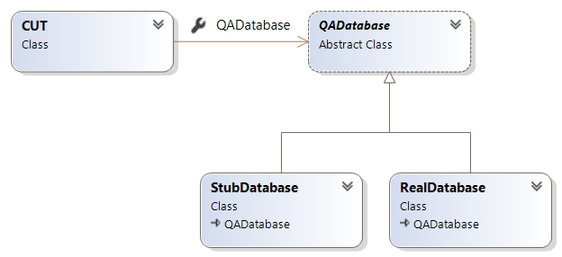
What is a Stub?
Represent a real dependency.
A class that returns pre-defined data to a test method.
Data remains constant.
Stubs don’t track system interactions; they only provide data.
Useful when mocking is too complex (e.g., for event handling).
Placed in the test app and should not be included in the live app package!

Slide 4

Creating stubs with C#

Slide 5

Stub – Using C# interface/Abstract class
public interface IQA_Database {
Product getProduct(int id);
}
public class StubQADatabase : IQA_Database {
Product[] products = { new Product(10,"Pen",50), new Product(80,"Ruler",1.20), new Product(99,"Paper",30.0) };
public Product getProduct(int id) {
//return the product with the given id
}
}
public class Order {
public bool ProcessOrders(IQA_Database database, int productID, int quantity) {
Product product = database.getProduct(productID);
/*
* Code to process the order. Code under test
*/
}
return true;
}
}
[TestMethod]
public void TestOrderProcessReturnsTrueForValidProductID() {
Order order = new Order();
Assert.IsTrue(order.ProcessOrders(new StubQADatabase(), 80, 5);
}

Slide 6
Using TestInitialize - Stubs with MS-Test
assertTrue
[TestClass]
public class QATests {
IQA_Database database;
[TestInitialize]
public void Setup()
{
database = new StubQADatabase();
}
[TestMethod]
public void TestOrderProcessReturnsTrueForValidProductID()
{
Order order = new Order();
Assert.IsTrue(order.ProcessOrders(database, 80, 5);
}
}

Slide 7


Creating stubs with Java

Slide 8
Stub – Using Java interface/Abstract class
public interface IQA_Database {
Product getProduct(int id);
}
public class StubQADatabase implements IQA_Database {
Product[] products = { new Product(10,"Pen",50), new Product(80,"Ruler",1.20), new Product(99,"Paper",30.0)};
public Product getProduct(int id) {
//return the product with the given id
}
}
public class Order {
public boolean ProcessOrders(IQA_Database database, int productID, int quantity) {
Product product = database.getProduct(productID);
/*
* Code to process the order. Code under test
*/
}
return true;
}
}
@Test
public void TestOrderProcessReturnsTrueForValidProductID() {
Order order = new Order();
AssertTrue(order.ProcessOrders(new StubQADatabase(), 80, 5);
}

Slide 9
Using @BeforeEach - Stubs with JUnit
public class QATests {
IQA_Database database;
@BeforeEach
public void setup()
{
database = new StuQADatabase();
}
@Test
public void TestOrderProcessReturnsTrueForValidProductID()
{
Order order = new Order();
AssertTrue(order.ProcessOrders(database, 80, 5);
}
}

Slide 10
Lab
Exercise
Please see your Exercise Guide
Notes:
Please see your Exercise Guide for full instructions.
Work individually or in pairs; your choice.
The exercise should take about 20 minutes.
Solutions are provided in the Exercise Guide for reference.

